Slide 1
Capstone Engagement
Assessment, Analysis, and Hardening of a Vulnerable System
Ben McCall August 2021
1diode@gmail.com

Slide 2
Table of Contents
This document contains the following sections:
01
Network Topology
02
Red Team: Security Assessment
03
Blue Team: Log Analysis and Attack Characterization
Hardening: Proposed Alarms and Mitigation Strategies
04

Slide 3
Network Topology
3

Slide 4
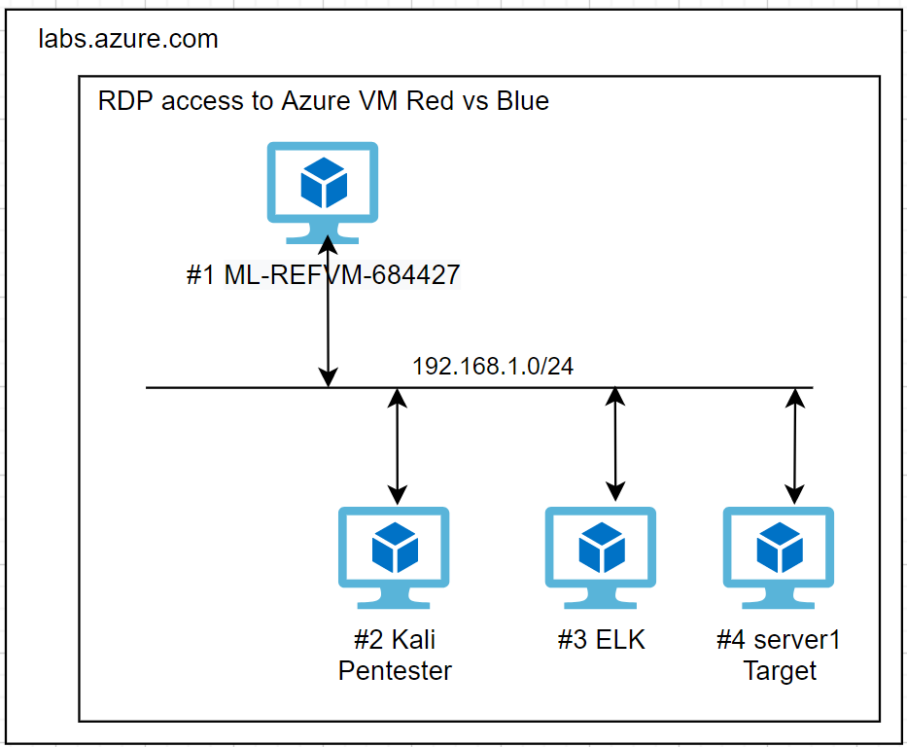
Network Topology
Network
Address Range:192.168.1.0
Netmask: /24
Gateway: 192.168.1.1
Machines
#1 IPv4:192.168.1.1
OS: Windows
Hostname: ML-REFVM-684427
#2 IPv4:192.168.1.90
OS: Unix
Hostname:kali
#3 IPv4:192.168.1.100
OS: Unix
Hostname: ELK
#4 IPv4:192.168.1.105
OS: Ubuntu
Hostname:server1

Slide 5

Red Team
Security Assessment
5

Slide 6
Recon: Describing the Target
Nmap identified the following hosts on the network:
Hostname | IP Address | Role on Network
ML-REFVM-684427 | 192.168.1.1 MAC ending .040D | Azure host For Hyper V VM facilitator
Kali | 192.168.1.90 MAC ending .0412 | Pentest machine
ELK | 192.168.1.100 MAC ending .D5D7 | Hosting the ELK stack Receiving Packet, Metric and Filebeats streams from server1
server1 | 192.168.1.105 MAC ending .040F | Target of attack and source of ELK stack metrics

Slide 7
Vulnerability Assessment
The assessment uncovered the following critical vulnerabilities in the target:
Vulnerability | Description | Impact
Server responds to ping Server TCP ports respond to test connections Server TCP ports open to scanning | Gather information about: Host IP addresses Open TCP port numbers TCP port service software versions | An active reconnaissance step revealing targets, information and touchpoints for exploitation Precursor to server access and takeover
Scanning for Hidden directories | Discovery of and traversal to, server directories that are not intended for the public | An active reconnaissance step that can be combined with information or credentials sourced elsewhere to obtain access/manipulate a server
Brute force attack | The combination of a known user name with a password dictionary to brute force a webserver or application logon page | A weaponization step where success provides unauthorized access to applications and functions
File uploads | User credentials can be observed on the network and captured for reuse | An exploit installation step where user credentials can be reused to gain access Access can be employed to position malicious payloads

Slide 8
Vulnerability Assessment - contd
The assessment uncovered the following critical vulnerabilities in the target:
Vulnerability | Description | Impact
Reverse shell (C2) | Activation of the malicious payload placed on server1 triggers a remote TCP connection back to the pentest machine. This connection can be turned into a remote shell | Complete Machine takeover. (CIA) Access to all data and user details Ability to modify data Ability to deny access to data or the machine
server1 TCP port 22 (SSH) version CVE-2019-6111CVE-2019-6110 | CVE exploits exist for SSH software version | Enables lateral movement steps that facilitate access, privilege escalation,data and credential extraction
server1 TCP port 80 (HTTP)version CVE-2018-1312 | Expliot enables remote access authentication bypass, no credentials required | A lateral movement step that facilitates further access, privilege escalation and credential extraction

Slide 9
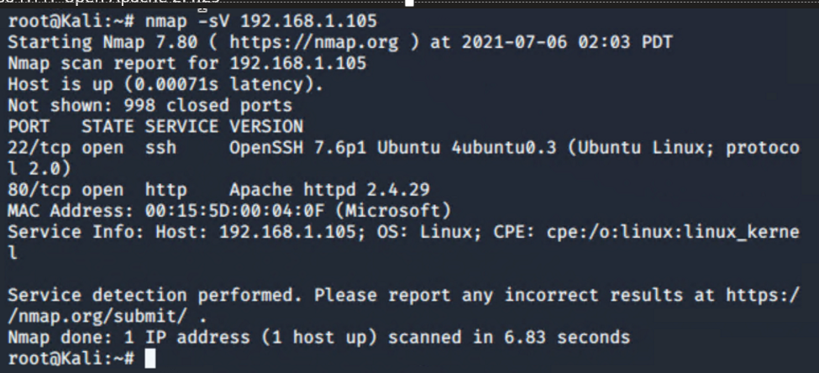
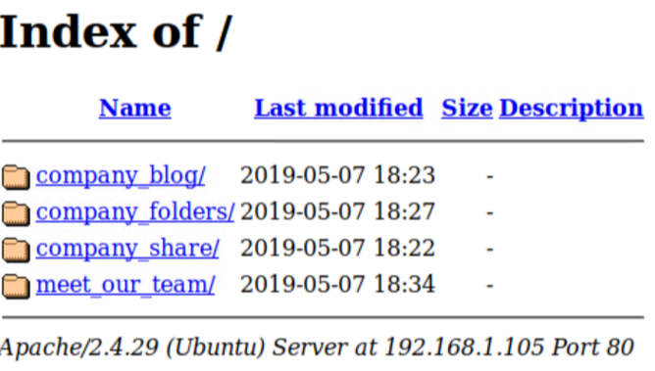
Exploitation: Port Scan - nmap
‘arp a’ for local subnet details
‘nmap 192.168.1.0/24’
3. nmap –sV 192.168.1.105.105
01
02
03
Tools & Processes
Employ Console @ pentest machine
Nmap discovery of hosts on network and their open TCP ports
nmap discovery of service and version per open TCP port
Achievements
Local subnet discovered 192.168.1.0/24
4 x hosts identified on subnet and their open TCP ports
Identification of the application and version per open TCP port
Result for server1 192.168.1.105 - Ubuntu
22 ssh open ssh 7.6p1
80 HTTP open Apache 2.4.29
Vulnerabilities exist for those SSH and Apache versions

Slide 10
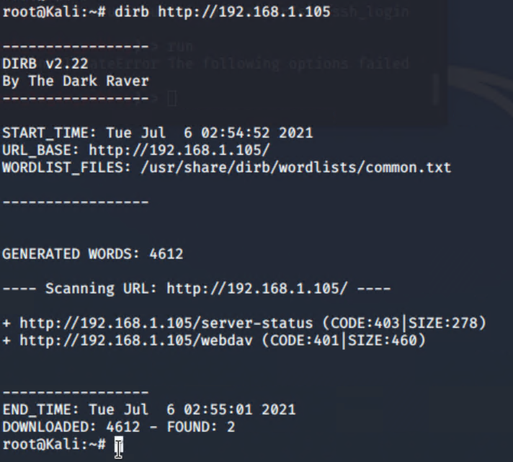
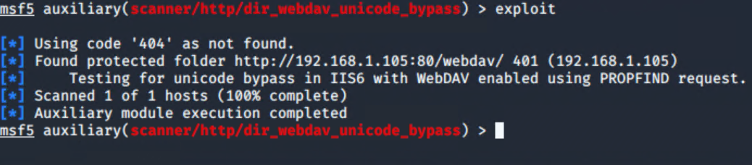
Exploitation: Hidden Directory Discovery - DirB
01
02
03
Tools & Processes
DirB (DirectoryBuster) scans a target server directory tree using a dictionary list
NB: Browsing the company website also revealed that a /company_folders/secret_folder is referenced in a personal BIO
Achievements
DirB identified two unseen web server directories
/server-status 403
/webdav 401
Metasploit msfconsole also found the /webdav directory

Slide 11
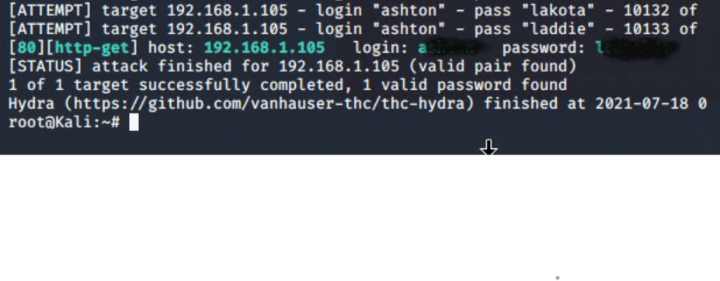
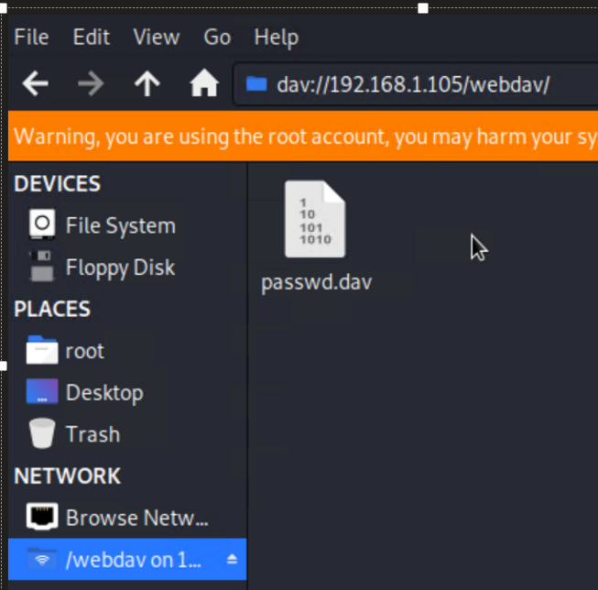
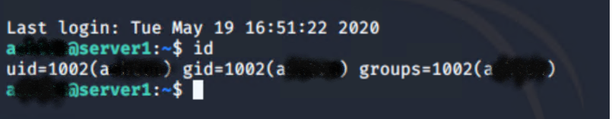
Exploitation: Brute Force Attack - Hydra
01
02
03
Tools & Processes
Hydra combines an already known username with a password dictionary to brute force a web login page
User ‘R’s password hash was cracked using the crackstation Webtool
Achievements
Hydra produced a password for user name ‘A…’
So read write access was gained to http://192.168.1.105/webdav via file explorer and web browser
Found in /webdav is the file ‘passwd.dav’ that contained instructions and password hash for user ‘R…’ to access /company_folders/secret_folder
NB: User A and R credentials also permit SSH to the target ‘server1’ An exploitation avenue

Slide 12
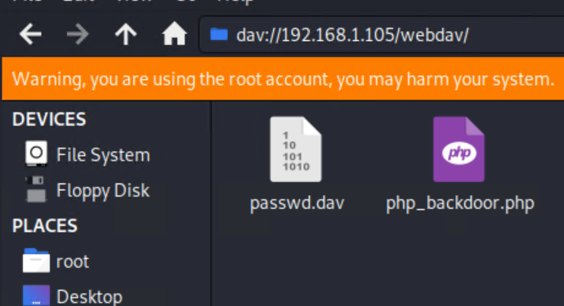
Exploitation: File upload /webdav
01
02
03
Tools & Processes
Employing user ‘R…’ credentials
File manager was used to access
dav://192.168.1.105/webdav
And via browser
http://192.168.1.105/webdav
Achievements
A malicious PHP payload file php_backdoor.php” created in the next step…
Was placed in the /webdav directory for future use
NB: /webdav is a HTTP/s extension permitting shared folders. Is commonly used as an administrative tool
In this case the HTTP authentication is in the clear and credentials not secure

Slide 13
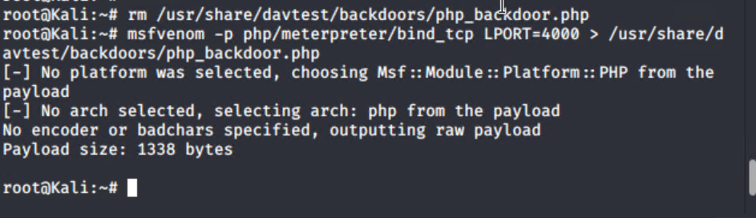
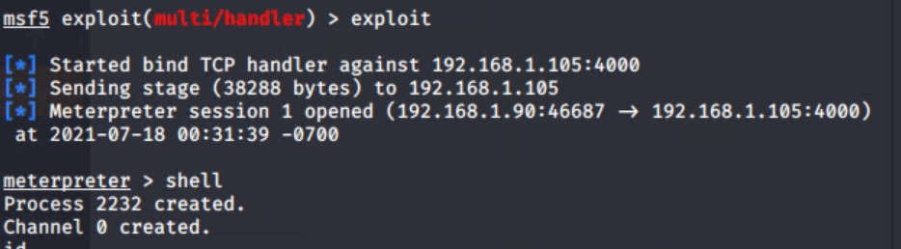
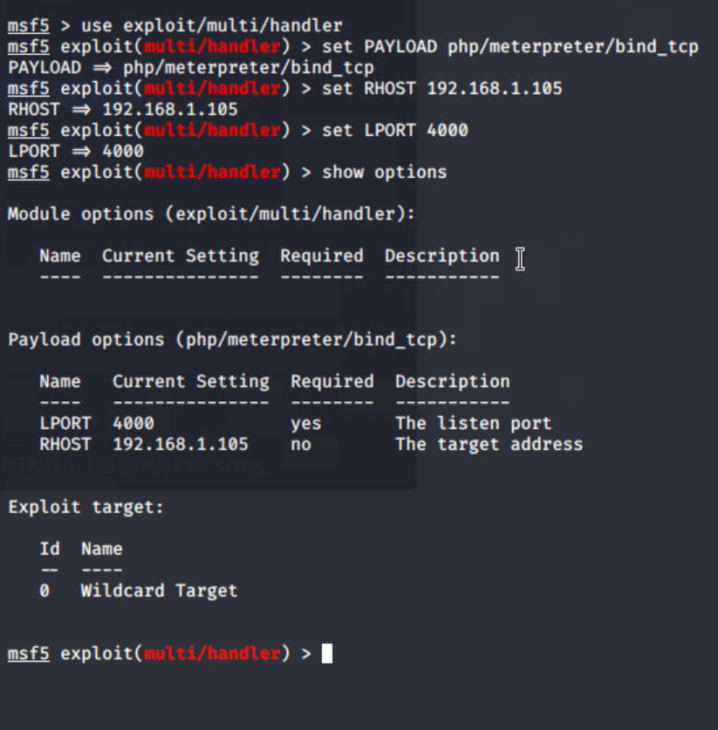
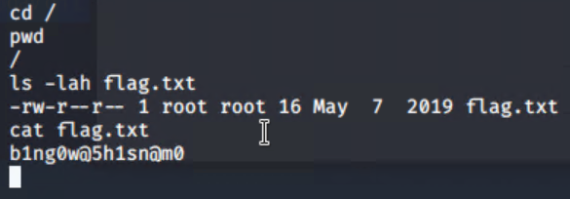
Exploitation: Reverse Shell
01
02
03
Tools & Processes
msfvenom was used to create php_backdoor.php payload payload
Achievements
A total takeover of server1
Web browsing the URL https://192.168.1.105/webdav/php_backdoor.php triggers a TCP connection on TCP port 4000 from the target back to pentest machine
At the pentest machine a meterpreter console starts
The command ‘shell’ provided a remote console with root privileges.
Remote shell On target host 192.168.1.105
Msfconsole
< Setup payload Handler. Enter ‘exploit’ to
Activate it

Slide 14

Blue Team
Log Analysis and Attack Characterization
14

Slide 15

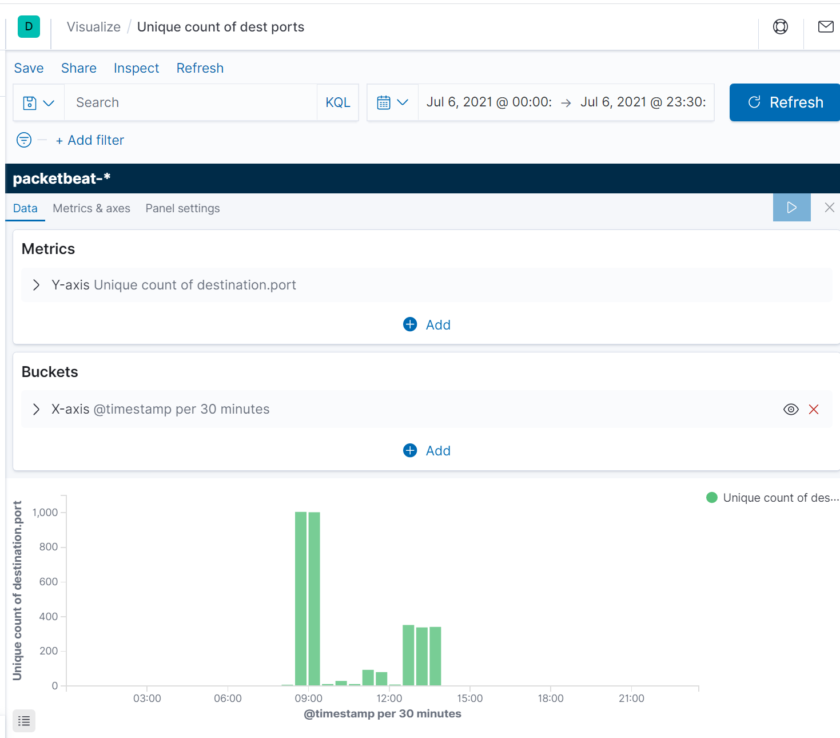
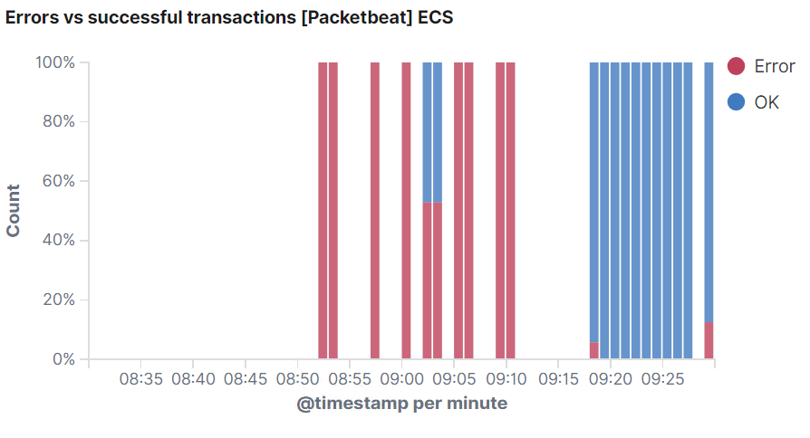
Analysis: Identifying the Port Scan - nmap
A port scan is detected when a single host receives a high number of unique TCP port numbers as TCP SYN connection attempts where TCP ports are not open
At 08:52am local time 91,983 packets were sent to 192.168.1.105
“unique count of destination ports” (port numbers) per 30 minute slice over 24 hours
Errors recorded when connection attempts to ports that don’t exist failed

Slide 16
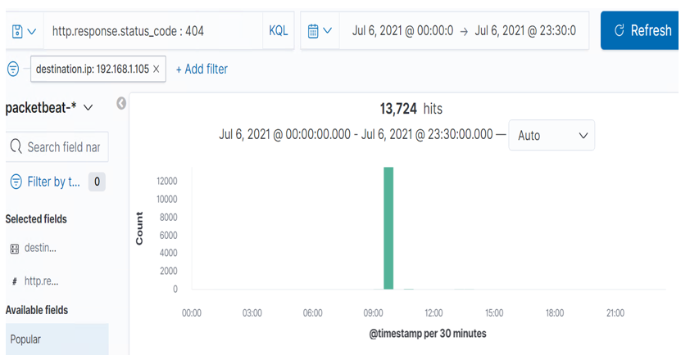
Analysis: Finding the Request for the Hidden Directory - DirB
2 additional folders on host 192.168.1.105 were discovered
Starting 9:54:21 local time 4612 attempts were made using DirB
Target folder: DIRB Result:
/Server_status 403 forbidden
/webdav 401 authentication required The login page is accessible
Else this chart= A high number of HTTP 404 “Not Found” responses are produced when non existent folders are tested by DirB NB: DirB was used multiple times

Slide 17
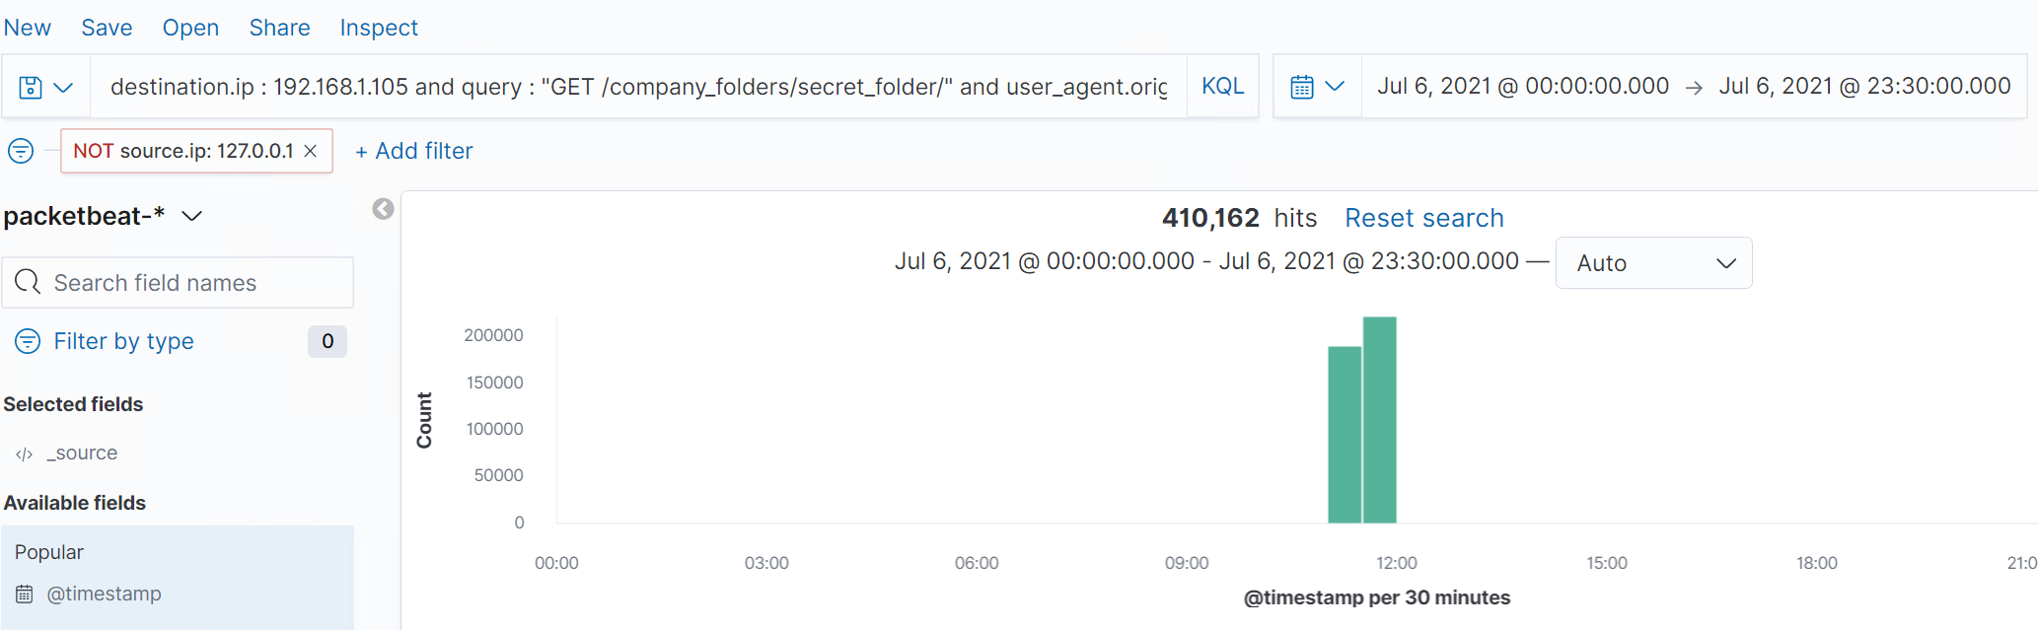
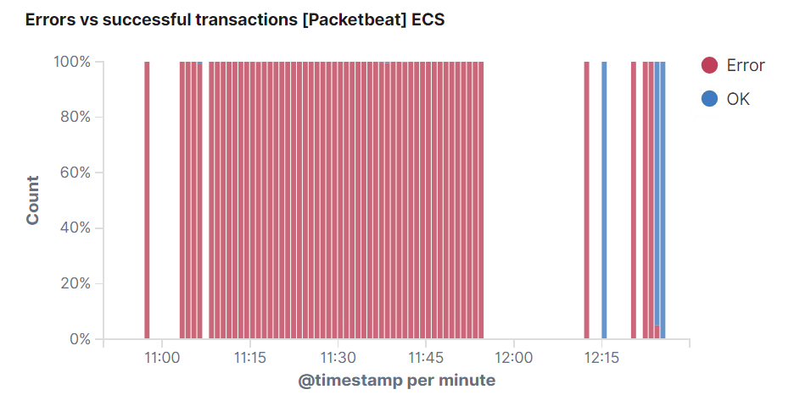
Analysis: Uncovering the Brute Force Attack - Hydra
A password for the user ‘a…’ was discovered
An attack comprising 410,162 packets brute force tested 10,134 passwords until successful
Discovered credentials were also sufficient for SSH access to server1
Failed attempts 11:00 to 12:00 received by pentest machine
destination.ip : 192.168.1.105 and query : "GET/company_folders/secret_folder/" and user_agent.original : "Mozilla/4.0 (Hydra)“
(NB: This search was specific to the Hydra tool – otherwise drop the user.agent part of search and look for excessive HTTP responses that are not 200) !=200

Slide 18
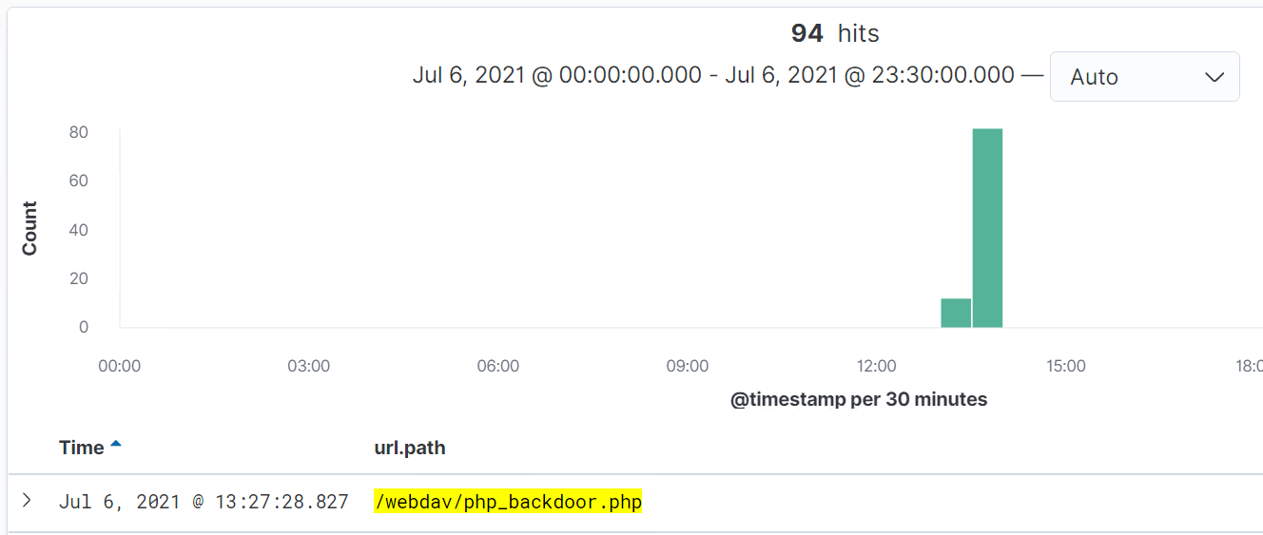
Analysis: Finding the WebDAV Connection
Webdav use can be identified by the the string ‘PROPFIND’ in kibana ‘query’ field
And via HTTP requests with uri.path to /webdav/ directory
Correct credentials provided read write access to the /webdav directory
Passwd.dav was retrieved from this folder revealing further information
Later at 13:27 the malicious payload ‘php_backdoor.php’ was placed in the /webdav directory for future use

Slide 19
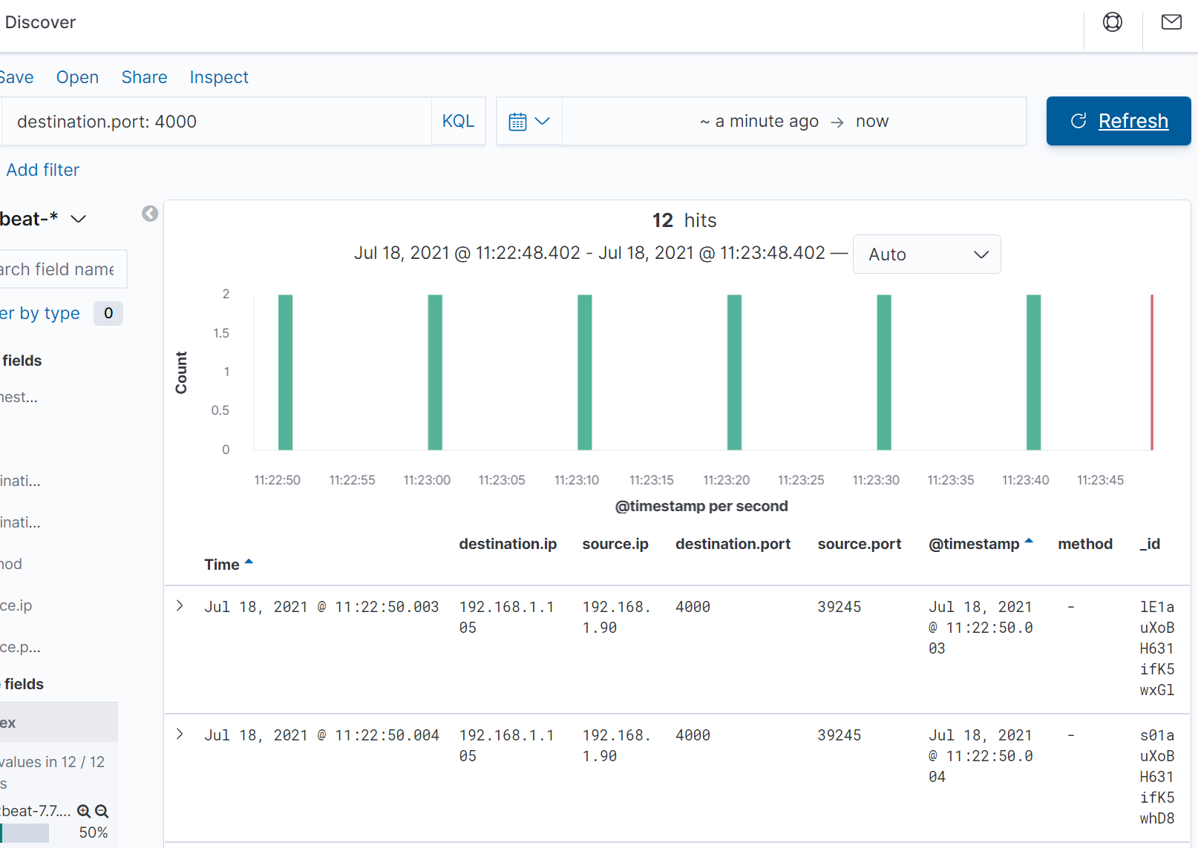
Analysis: Finding the Reverse Shell Connection - Meterpreter
msfconsole TCP reverse shell use may be detected by a unique default user agent string “Mozilla/4.0 (compatible; MSIE 6.1; Windows NT)” However this can be changed by the user
The remote exploit PHP client always sends a form of POST request as a keep alive with a 4-byte payload: containing ‘RECV’ every 10 seconds
As @ 2016 Metasploit’s source code is hardcoded to do this
When tested Packetbeat appears unable to observe either of the above – all I can see is based on port number 4000 which is prior knowledge
An Investment in Firewall packet inspection is required
NB: I found little that explained how to detect the reverse shell
Test Wireshark captures are remarkable for whats missing from frames
To do:
Examine the PHP exploit payload for insight into operation
Research how the exploit uses target machine memory and hides
Pull apart detection rules from the likes of F5 for ideas
And ask Brendan @ Monash
Reverse shell keep alive packets when TCP port number is known
Personal pursuit

Slide 20
Blue Team
Proposed Alarms and Mitigation Strategies
20

Slide 21
Mitigation: Blocking the Port Scan - nmap
Alert when a single source IP address exceeds 10 different TCP port number connections per second
Alert upon detection of TCP port numbers that are outside of the range used by the organisation (determined by audit)
Close server1 TCP if ports not in use
Place rules on ports to accept connections from authorised sources only EG a jumpbox
Employ
‘sudo ufw deny 80/tcp’ to block TCP port
To permit webdav and HTTP access from a jumpbox only to server1
‘sudo ufw allow proto tcp from <jumpbox ip> to 192.168.1.105 port 80’

Slide 22
Mitigation: Finding the Request for the Hidden Directory - DirB
Alert and or prevent forbidden URL use
An alert setting of ‘threshold = zero’ will alert for every single event
Block forbidden URL access at network layer
Prevent directory traversal
Set apache server to not disclose hidden folders or allow directory traversal
Alert upon detection of packets containing the ‘url.path: */secret_folder or */webdav’ in kibana
Apache:
A know mitigant exists regarding
LoadModule rewrite_module modules/mod_rewrite.so
Link

Slide 23
Mitigation: Preventing Brute Force Attacks - Hydra
While Apache possesses user and password brute force counter measures. It has little for brute force directory tree exploration
A unix module called ‘evasive’ assists with DOS, DDOS and brute force attacks
#apt-get install libapache2-mod-evasive
Link
Detect excessive response codes that are not HTTP 200
Thus capturing HTTP response codes including 401 unauthorized (EG Hidden) 403 Access forbidden (EG Logon required)
404 File not found (No Dir or file)
Carry out a survey and use 3x previous peak for a select time period as the threshold.
Being mindful of false alarms vs ‘low and slow’ living off the land attacks

Slide 24
Mitigation: Detecting the WebDAV Connection
Alert upon detection of access to the /webdav directory
Threshold = zero to alert upon every instance
Limit network access to TCP port 80 on server1
Firewall rule to permit webdav and HTTP from only a jumpbox to server1
‘sudo ufw allow proto tcp from <jumpbox ip> to 192.168.1.105 port 80’
Layer these with configuration or policy for tougher passwords.
Test existing user passwords against dictionaries used by attackers

Slide 25
Thank you
25

